Slide 1


Smart Vehicle Parking system

Slide 3
What is smart Parking?’
In the modern world, due to emerging vehicle population, congestion in cities, parking has become a real time headache. Many a times we find it difficult to maneouvre our vehicles and find the right and safe parking spot for it. Smart Parking Solutions are blooming as an ideal remedy for the same. It utilizes the technologies like IoT, sensors, cameras, client friendly interfaces, which guide the user to register their vehicle in the record book of the authority automatically, and find a vacant , safe spot in a jiffy. All the processes are automated and doesn’t require human intervention which makes it efficient for both the authority and the client. It makes Parking a smart move rather than a boring everyday task.
here is a list of the top benefits why to consider deploying a smart parking solution:
Reduces unnecessary vehicle emissions caused by parking search traffic
Saves time and hassle for drivers to find (and pay) for their ideal parking space quickly and easily
Generates data that can be leveraged to connect other modes of transportation - hints the concept of a mobility hub. Such as ride-sharing, bike hire, scooters or public transportation.

Slide 4
MECHANISM OF OUR PROJECT

Slide 5
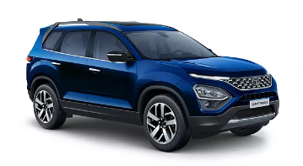


Smart Parking System
Data captured
“JH 10 CX 0000”

Slide 6
Smart Parking System
Data captured
“JH 10 CX 0000”
Data registered in SQL Database

Slide 7
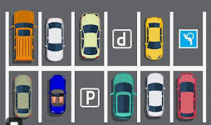
Smart Parking System
Data captured
“JH 10 CX 0000”
Data registered in SQL Database

Slide 8
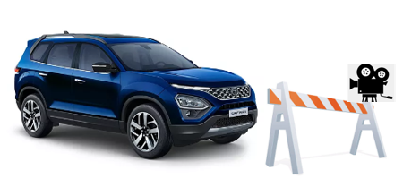
Smart Parking System
In time and rc info
RC Plate captured
“JH 10 CX 0005”
Data registered in SQL Database
Out time and fare
Calculate in, out, parked time and fare
Check available parking spot

